Slide 1
Socket programming
Lab 2

Slide 2
Why Socket Programming
Sockets and the socket API are used to send messages across a network.
They provide a form of interprocess communication (IPC).
E.g.
To build any application
E.g. www (Firefox, Google chrome)
P2P (Bitcomet, cryptowallet)

Slide 3
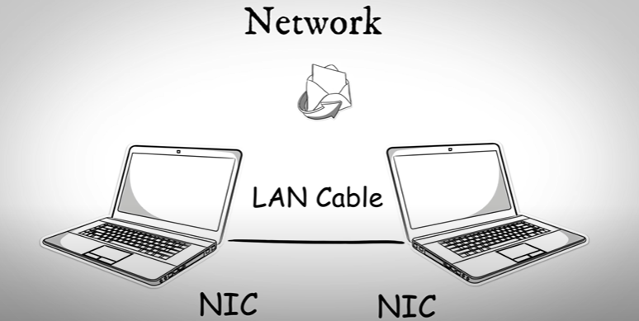

Computer Network
Two or more then two Devices Connected with each other
may or may not share data
through Medium Such as communication links or routers (fiber optics, satellite)

Slide 4





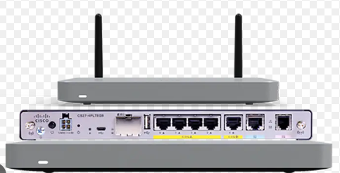
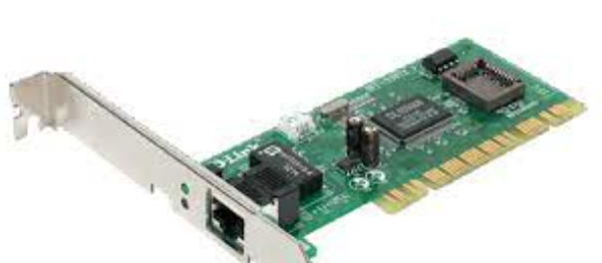


TCP/IP
Application Layer
HTTP,FTP,SMTP
DATA
Application Layer
Transport Layer
TCP/UDP
Transport Layer
TCP/UDP
Socket
Socket
Network Layer
IP
Network Layer
IP
Datagram Packet
Frames
Data Link Layer
PPP/LCP
Data Link Layer
PPP/LCP
Physical Layer (bits)

Slide 5
To Understand Socket programming
How we can call John wick?
What things(Devices and tech) we need to call?
How call will be connected?
ANS:
1. Both parties have telephone installed socket()
2. A unique phone number Bind()
3. Turn on ringer to listen caller Listen()
4. Caller dial a number. Connect ()
and receiver pick phone. Accept()
5. Talk to each other. Send(), Recv()
6. After conversation call end. Close()
Notes:
https://www.youtube.com/watch?v=c_k8_DMuY54

Slide 6
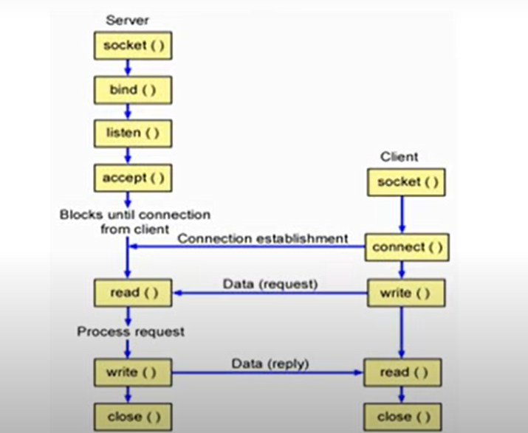
TCP client server socket programming

Slide 7
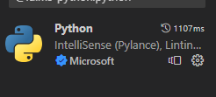
Python issues and solutions
1. Download python
https://www.python.org/downloads/
2. install python plugin in vscode for py script
Ans: install python3
Python was not found
https://www.youtube.com/watch?v=uBnbVqUmZaQ

Slide 8
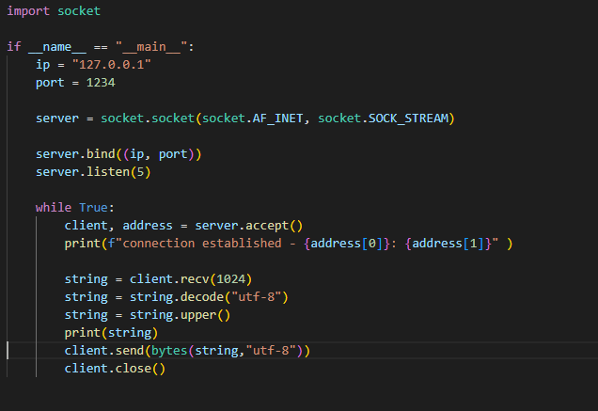

Slide 9
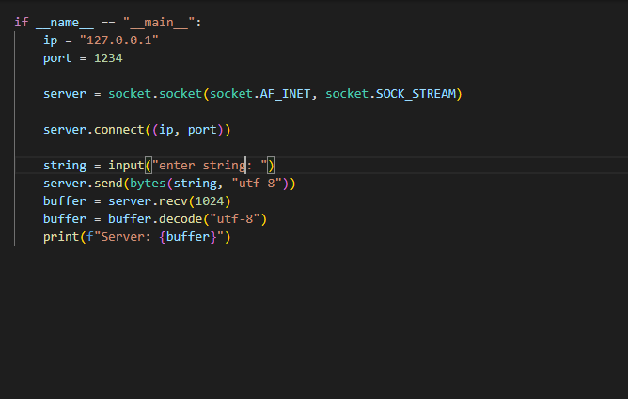
Notes:
https://www.youtube.com/watch?v=GlVfVn17_ug&t=192s

Slide 10
Server.py
import socket
if __name__ == "__main__":
ip = "127.0.0.1"
port = 1234
server = socket.socket(socket.AF_INET, socket.SOCK_STREAM)
server.bind((ip, port))
server.listen(5)
while True:
client, address = server.accept()
print(f"connection established - {address[0]}: {address[1]}" )
string = client.recv(1024)
string = string.decode("utf-8")
string = string.upper()
print(string)
client.send(bytes(string,"utf-8"))
client.close()

Slide 11
Client.py
import socket
if __name__ == "__main__":
ip = "127.0.0.1"
port = 1234
server = socket.socket(socket.AF_INET, socket.SOCK_STREAM)
server.connect((ip, port))
string = input("enter string: ")
server.send(bytes(string, "utf-8"))
buffer = server.recv(1024)
buffer = buffer.decode("utf-8")
print(f"Server: {buffer}")

